Slide 1
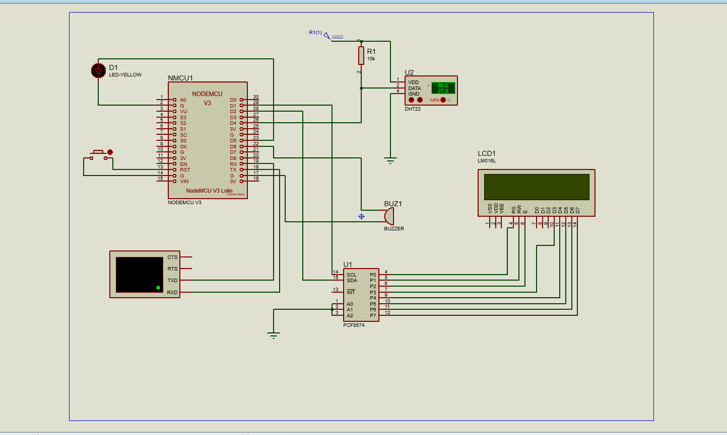
Proteus Simulation

Slide 2
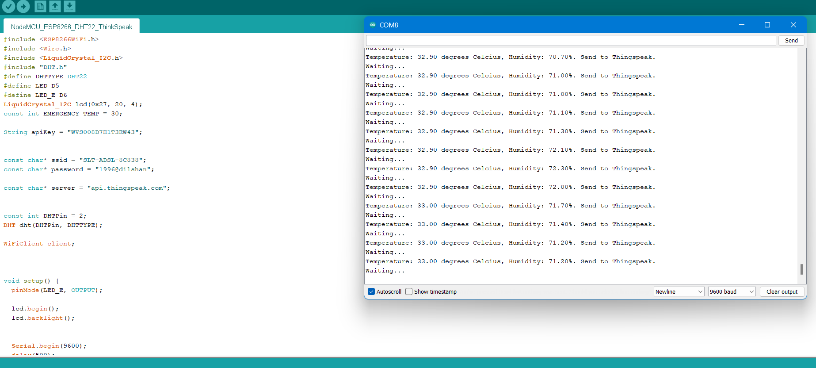
Prototype and Serial Monitor

Slide 3
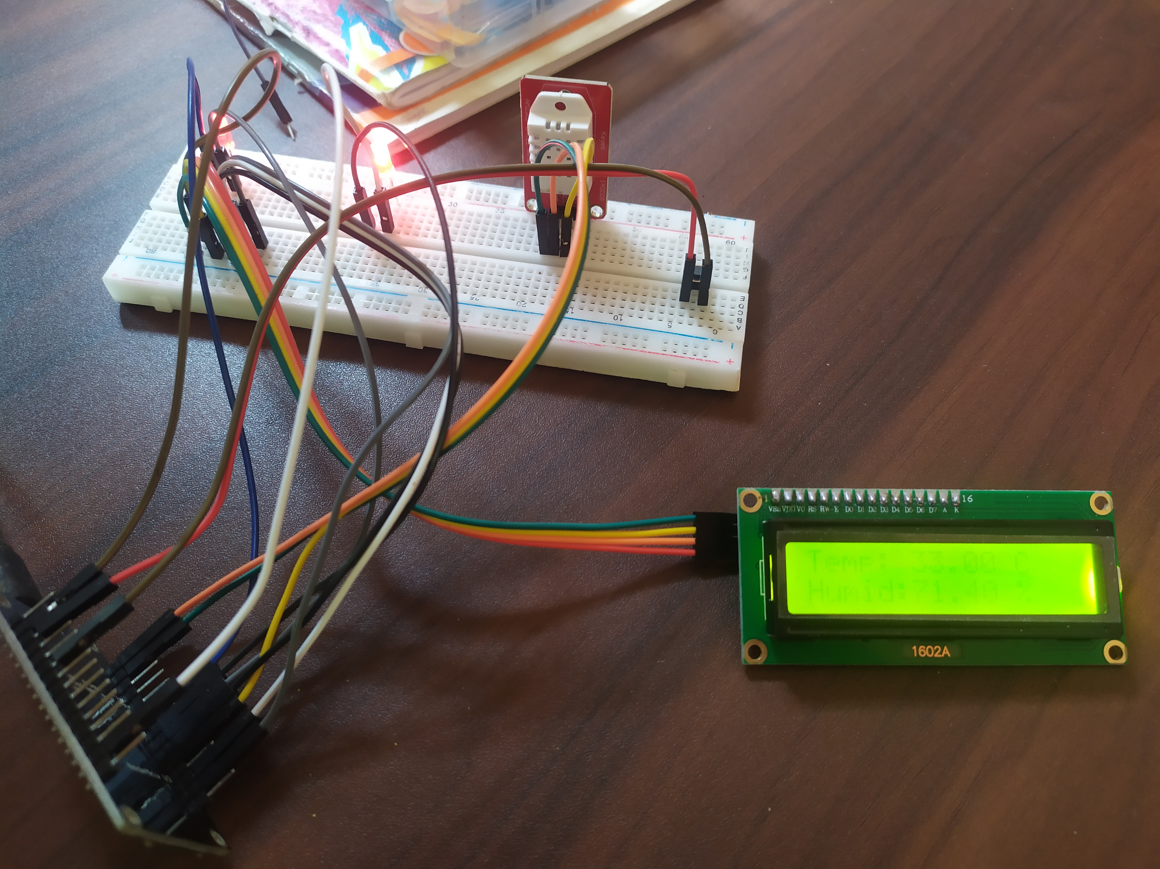
DHT Sensor
Emergency LED
Reset
LED Indicator
LCD Display
NodeMCU

Slide 4
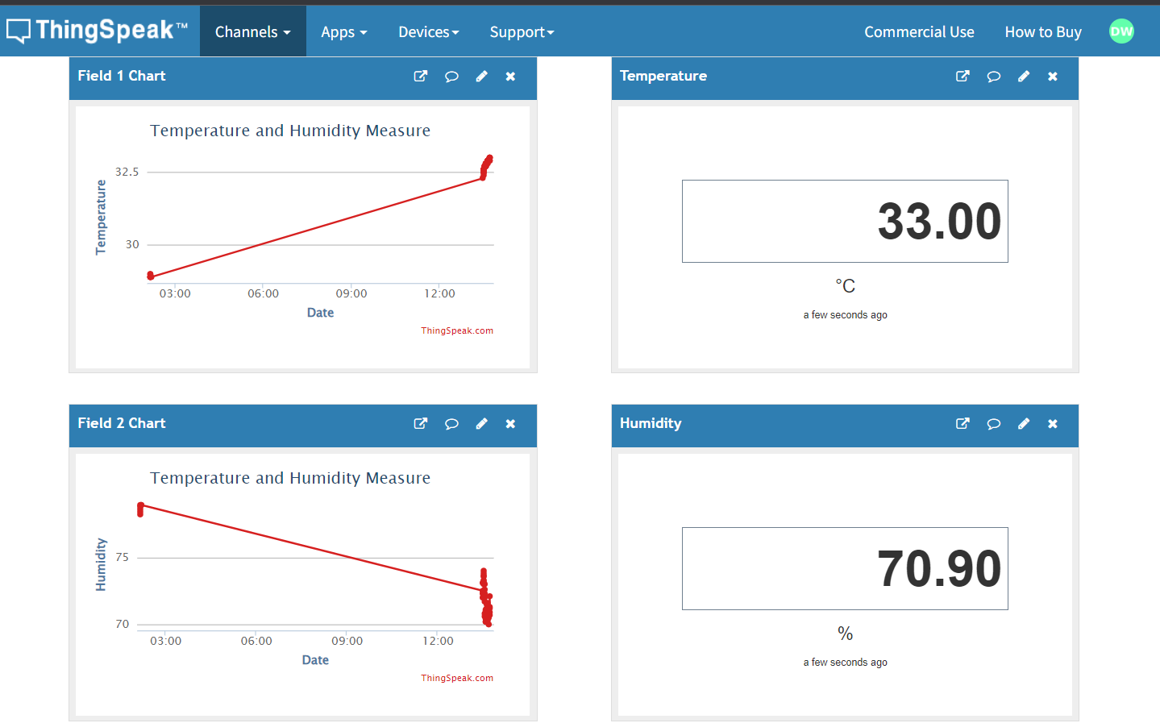
Cloud Interface

Slide 5
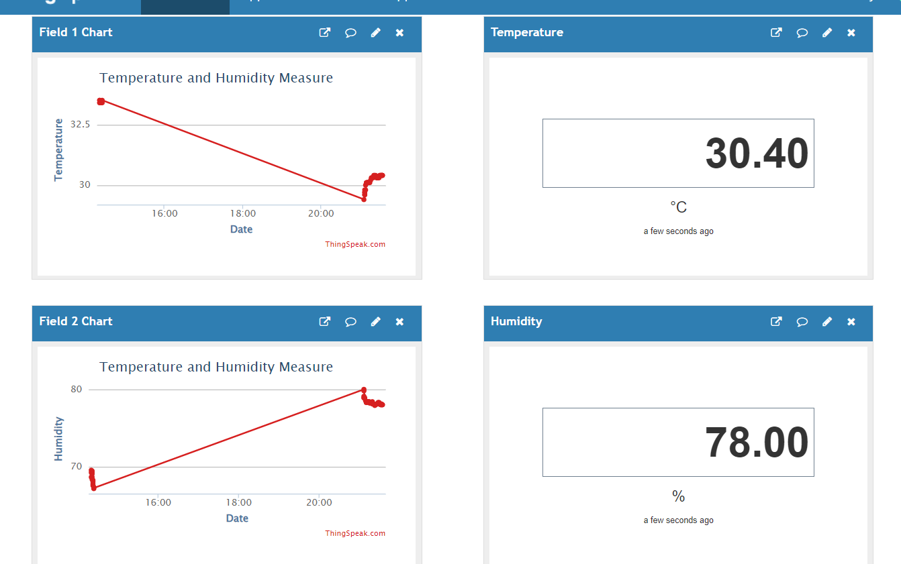
When temperature is below 32 Celsius Emergency LED will be off

Slide 6
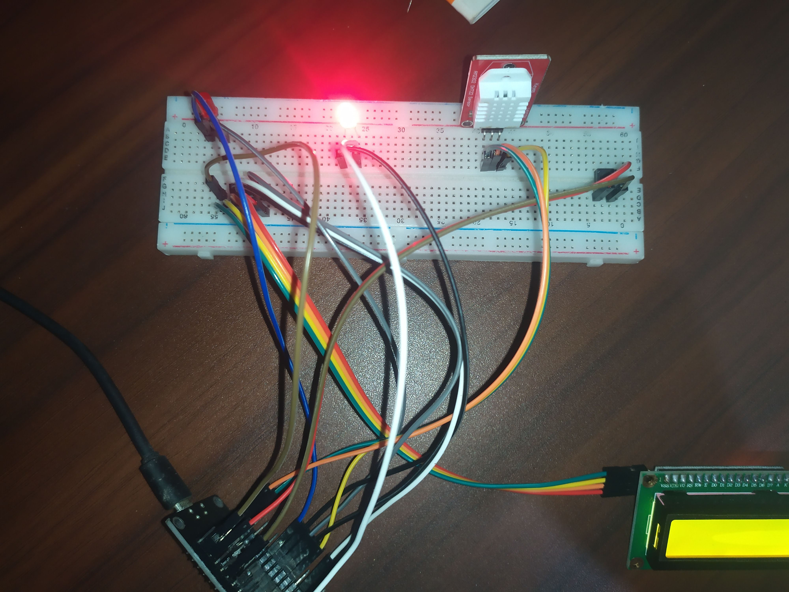
LED OFF
Emergency LED

Slide 7
When temperature is upto 32 Celsius Emergency LED will be on

Slide 8
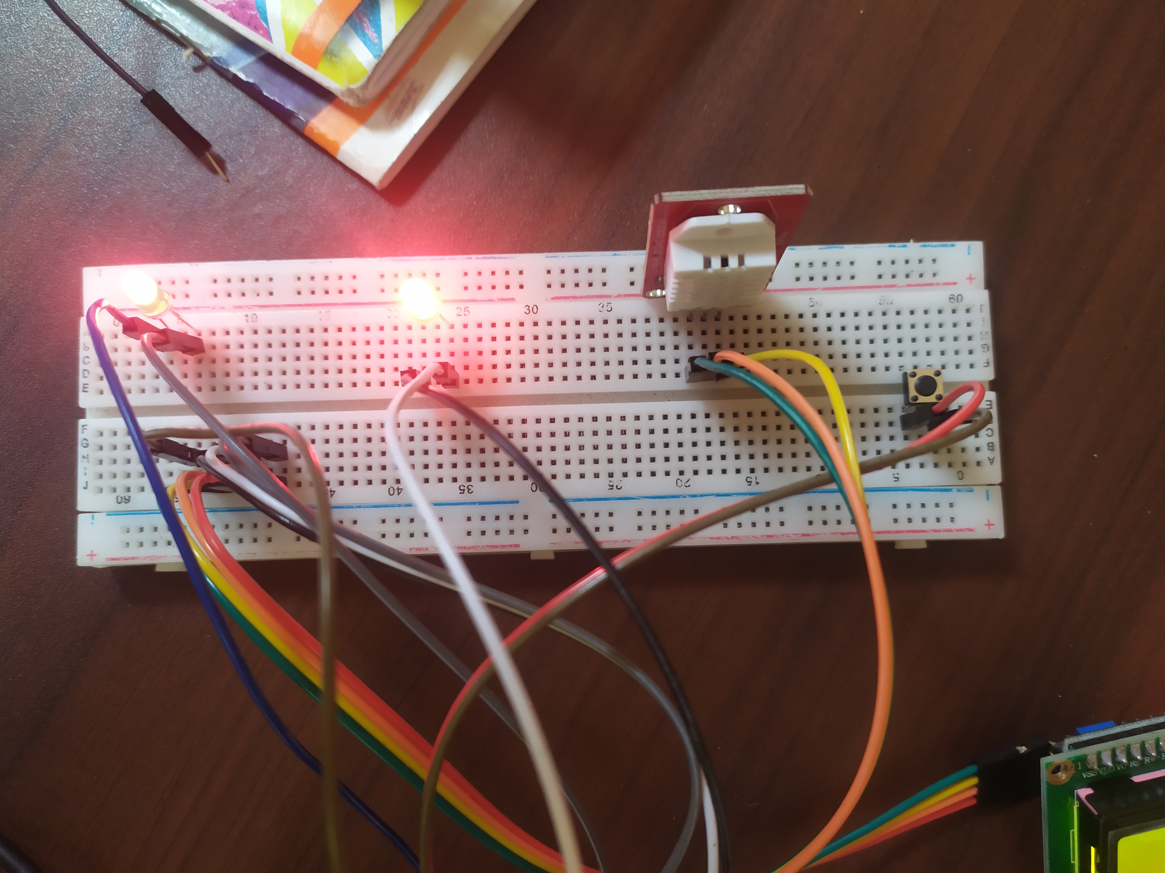
LED ON
Emergency LED

